Slide 1
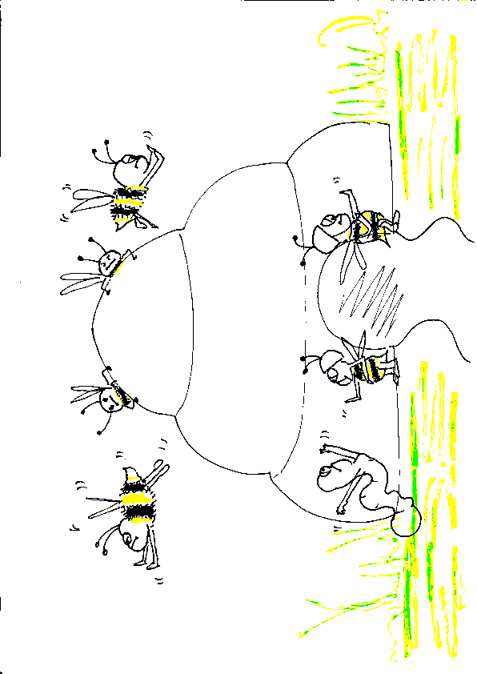
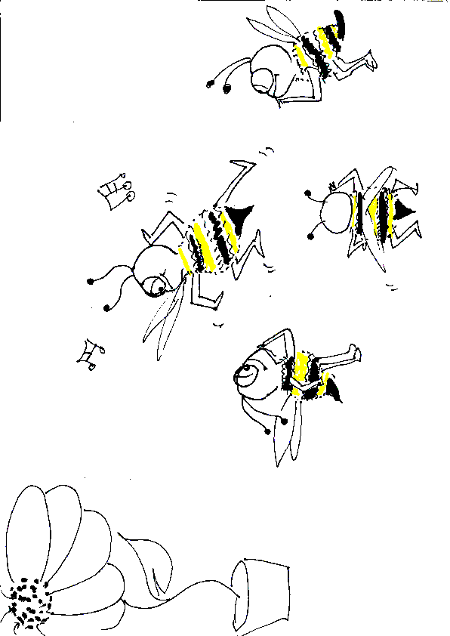
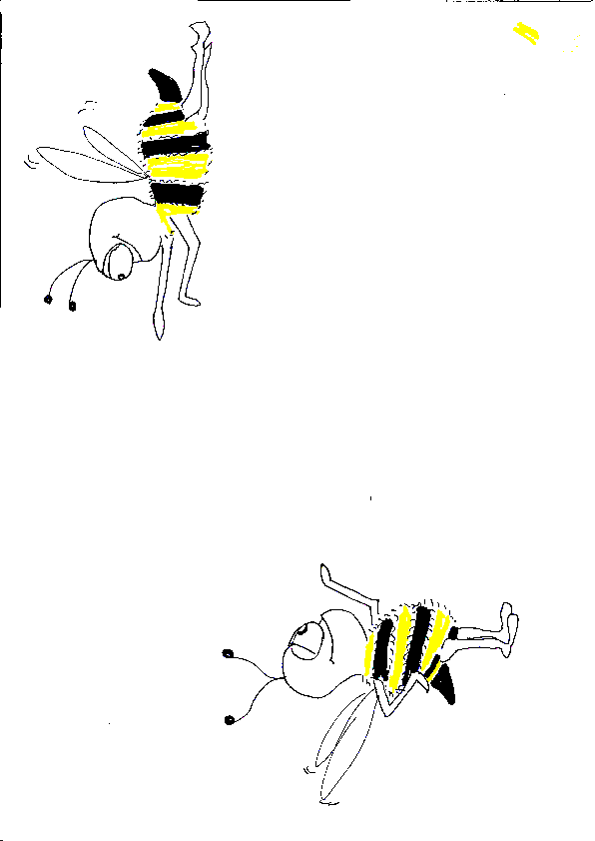
Reacting to the future of application architecture
Grace Jansen
Developer Advocate
IBM
Twitter @gracejansen27

Slide 2
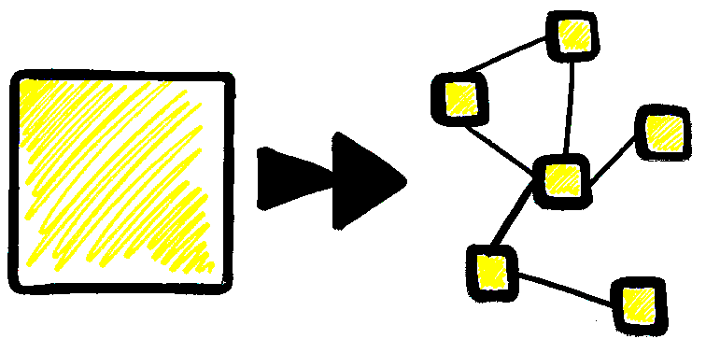
Evolution of software
@gracejansen27
Notes:
A single website may now handle as much traffic as the entire internet did a decade ago!!
Distribute out different services
Easily add features, deploy small part of application
Isolate failure
New problems --> users have new ever-demanding expectations
Doesn't expect an application to fail or have no access
Expect responses as soon as they click
Shopping cart example
How can we tackle these new demands and expectations user's put on applications?
Where do we go in our evolution?
Biology background inspiration --> nature inspire our apps
Bees = system of individuals, independent but common goal

Slide 3
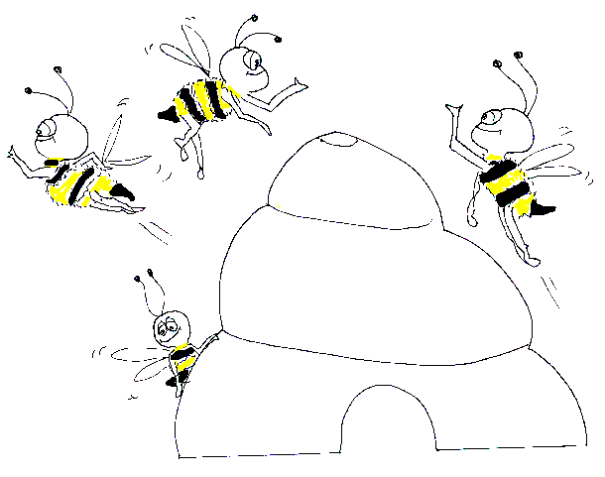
Bees and Software Link
@gracejansen27
Notes:
The 100 million-year-old fossil was found in a mine in the Hukawng Valley of Myanmar (Burma) and preserved in amber.
Discovered in 2006

Slide 4
Food Foraging
@gracejansen27
Notes:
Independant Observers
Act as soon as possible - quick to respond

Slide 5
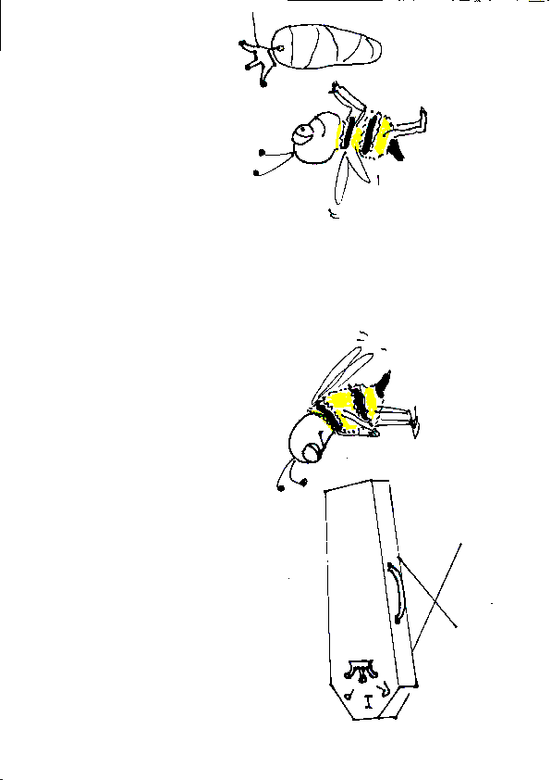
Long Live the Queen
@gracejansen27
Notes:
Colony Independently continues
Impact of Queen being lost is managed
Has the potential to be catastrophic but isn’t

Slide 6
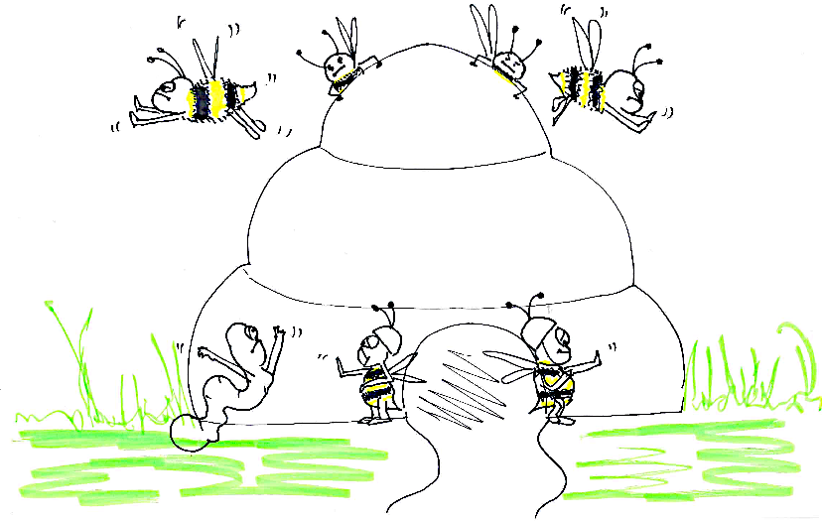
Bees at War
@gracejansen27
Notes:
Guards recruit more bees to defend hive
Limited number of bees - so switch roles to make up numbers and go back to original role after
Dynamically increase number of guards

Slide 7

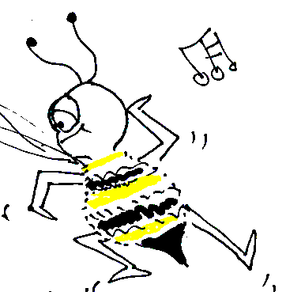

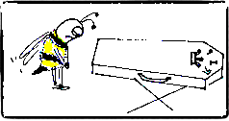
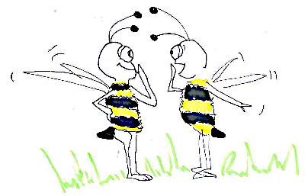
Reactive Manifesto
Responsive
Elastic
Resilient
Message-Driven
@gracejansen27
Notes:
Creation of the Reactive Manifesto in 2013, by Jonas Bonér
to collaborate and solidify what the core principles were for building reactive applications and systems
REACT to users (Responsive)- user click a button
REACT to load (Elastic) - black friday and login/book table
REACT to failure (Resilient) - monitor, replace service
REACT to events (event-driven) - achieve other 3 principles
how do we achieve this? same way bees do
async comm - dancer bee, guard bee recruiting
Let’s say that our system should:
. Be responsive to interactions with its users
. Handle failure and remain available during outages
. Strive under varying load conditions
. Be able to send, receive, and route messages in varying network conditions
These answers actually convey the core reactive traits as defined in the manifesto.
It is important to realize that reactive traits not only set you up for success right now, but also play very well with where the industry is headed, toward location-transparent, ops-less distributed services.

Slide 8
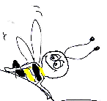
Reactive Architecture, the future of application architecture?
@gracejansen27
Notes:
bees = sophisticated system, appear simplistic, actually complicated
efficient society of independent individuals acting as a whole
We want to mimic what bees have achieved - tall ask, bees have had millennia, but by implementing reactive architecture we can start to achieve this

Slide 9
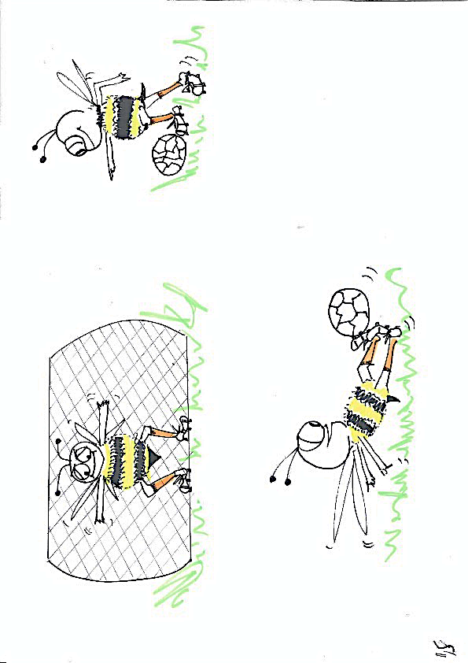
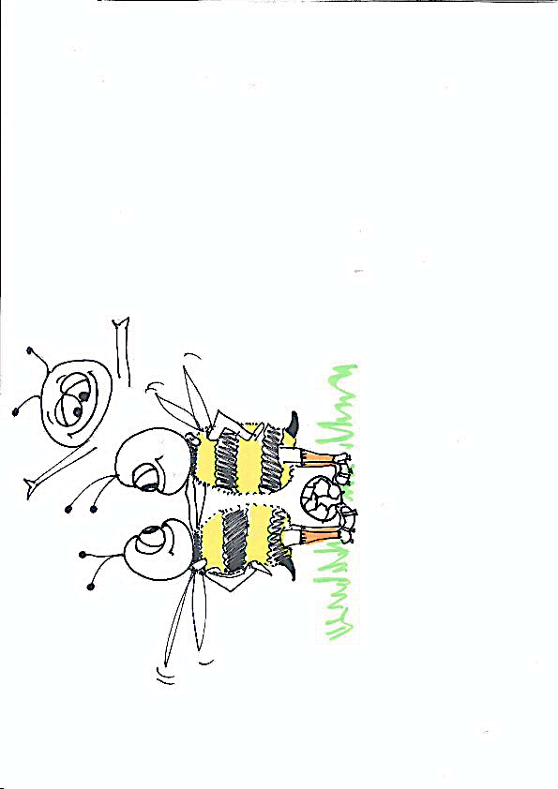
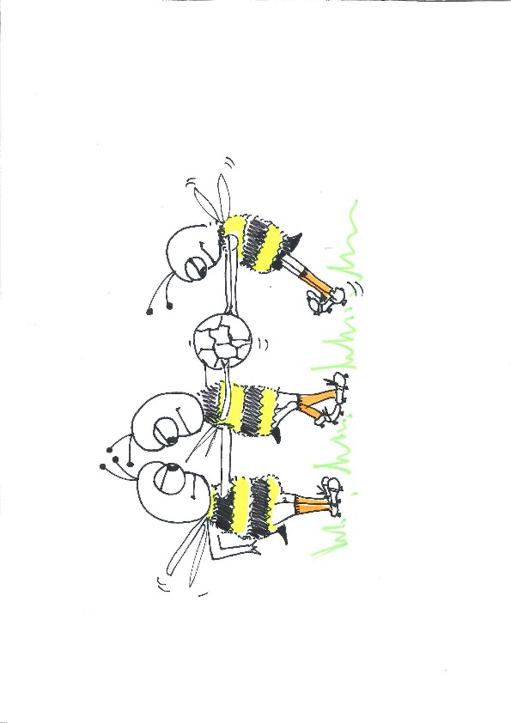
Reactive programming vs Reactive systems
VS
@gracejansen27
Notes:
If it’s our goal to build responsive applications in an event-driven world, we need to be making sure we are getting the most out of the hardware on which we’re running. We do this through concurrency and parallelism.
Reactive programming is one tool which aims to try and tackle this.
Reactive programming is a great technique for managing internal logic and dataflow transformation, locally within the components, as a way of optimizing code clarity, performance and resource efficiency.
Reactive systems puts the emphasis on distributed communication and gives us tools to tackle resilience and elasticity in distributed systems.
Reactive programming is a paradigm in which declarative code is used in order to construct asynchronous processing pipelines.
Translated, this is essentially the same process our minds perform when we try to multitask. Rather than true parallel tasking, we actually switch tasks and split those tasks efficiently during their duration. This method of switching tasks enables us to efficiently use our time instead of having to wait for the previous task to complete. This is exactly what reactive programming was created to enable and is an event-based model in which data is pushed to a consumer, as it becomes available turning it into an asynchronous sequences of events.
Reactive programming is a very useful implementation technique for managing internal logic and dataflow transformation, locally within components. However, once there are multiple nodes, there is a need to start thinking hard about things like data consitency, cross-node communication, orchestration, failure management, separation of concerns and responsibilities, etc, i.e. there is a need to think about system architecture. Reactive programming cannot address these issues or address the need for resilience and elasticity within a system. So, instead, to maximize the value of reactive programming, it’s recommended to use it as a tool to build a reactive system.

Slide 10
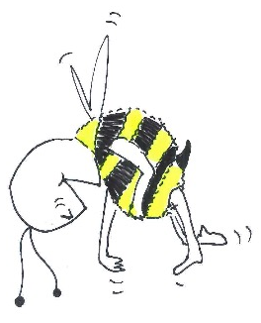
So, how can we enable these reactive bee-haviours?
@gracejansen27
Notes:
Architectural tools – enable reactive behaviours

Slide 11
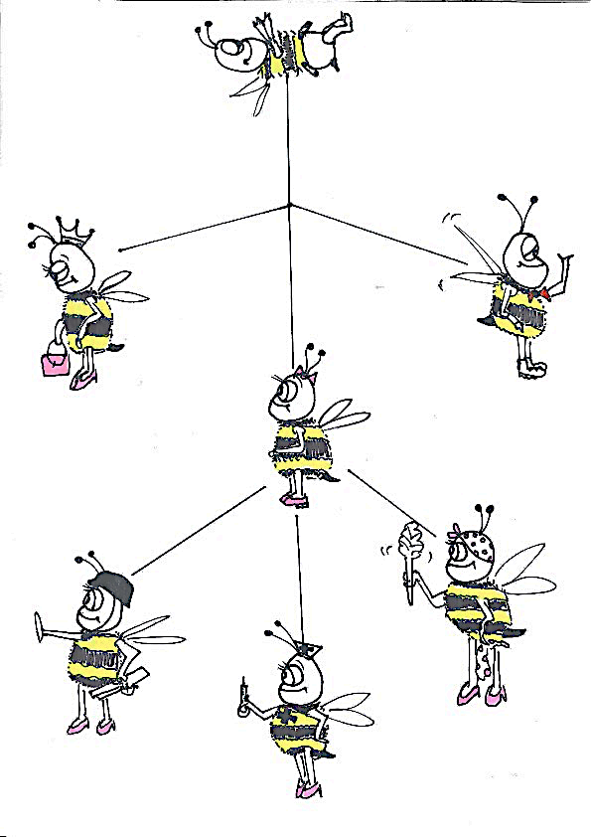
Domain Driven Design (DDD)
Context
Model
Bounded Context
Ubiquitous Language
Aggregate Roots
@gracejansen27
Notes:
Sphere of knowledge or activity
Subject area on which the application is intended to apply
Development approach as opposed to a physical tool
Aims to ease the creation of complex applications – divides up large systems into bounded contexts
A DDD aggregate is a cluster of domain objects that can be treated as a single unit.
An aggregate will have one aggregate root.
DDD = independent areas of a problem as bounded contexts, emphasises a common language to talk
Any references from outside the aggregate should only go to the aggregate root. The root can thus ensure the integrity of the aggregate as a whole. How do we achieve efficient communication across these bounded contexts/services?
Focus on the core domain and domain logic.
Base complex designs on models of the domain.
Constantly collaborate with domain experts, in order to improve the application model and resolve any emerging domain-related issues.
Message-driven
Lagom framework

Slide 12
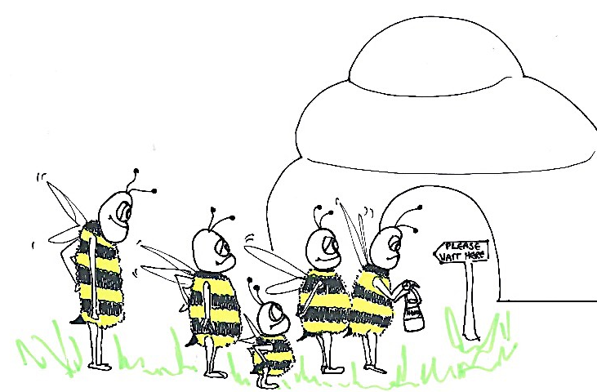
Asynchronous Communication
@gracejansen27
Notes:
Communication between Microservices needs to be based on Asynchronous Message-Passing
An asynchronous boundary between services is necessary in order to decouple them, and their communication flow, in time—allowing concurrency—and in space—allowing distribution and mobility. Without this decoupling it is impossible to reach the level of compartmentalization and containment needed for isolation and resilience.
Asynchronous and non-blocking execution = more cost-efficient through more efficient use of resources, minimizes contention (congestion) on shared resources in the system, which is one of the biggest hurdles to scalability, low latency, and high throughput.
It’s best illustrated with an example… bees queuing = wasted resource, equivalent to threads
But why is blocking so bad?
The fundamental shift is that we’ve moved from "data at rest" to "data in motion.
Applications today need to react to changes in data in close to real time—when it happens
First Wave = data at rest, batch processing, hours of latency, overnight
Second Wave = hybrid architecture, lambda architecture, 2 layers (batch and speed layers), added needless complexity – 2 data pipelines and need to merge them afterwards
Third Wave – fully embrace data in motion, stream processing architecture, event logging/sourcing…..
Lagom framework
Message-driven / responsiveness

Slide 13
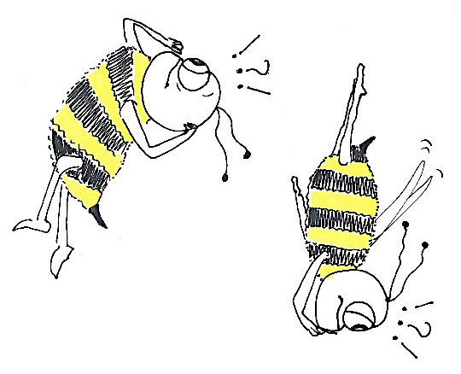
Event-Sourcing/CQRS
@gracejansen27
Notes:
Event Sourcing ensures that all changes to application state are stored as a sequence of events
(e.g. business objects is persisted by storing a sequence of state changing events)
Command Query Responsibility Segregation --> disassociate writes (commands) and reads (queries)
Applying event sourcing on top of CQRS means persisting each event on the write part of the application.
Read part is derived from the sequence of events.
Bees brains = local databases
Dance floor – write to bees brains
Bees can query their own brains (read)
May not be most up to date but that’s ok
Responsiveness
Lagom framework

Slide 14

High Availability / Eventual Consistency
@gracejansen27
Notes:
Tradeoff
Dance floor → bees assume the food is still available until another bee comes back and says otherwise
More representative of the way the world works
Given enough time, all nodes will become consistent
Not perfect → sharding to help improve consistency
Lagom framework
CAP Theorum

Slide 15
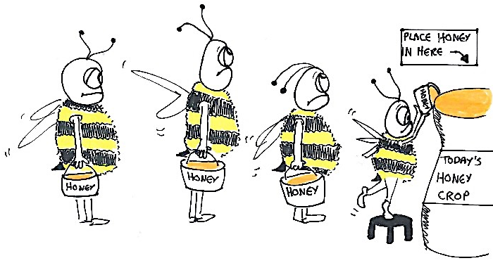
Sharding
@gracejansen27
Notes:
Form of Database partitioning, separates very large databases into smaller, faster, more manageable parts called data shards
Shard = small parts of a whole
Meant to make v. large databases more manageable
Greater parallelism, without collisions
Two bees at the same cell – fill up multiple cells (sharding)
Finite space in the hive – sharding out the hive into cells – operate in parallel across cells, reducing contention
Imagine one huge cell, only one bee can fill up at a time
Resiliency/elasticity
Lagom framework

Slide 16
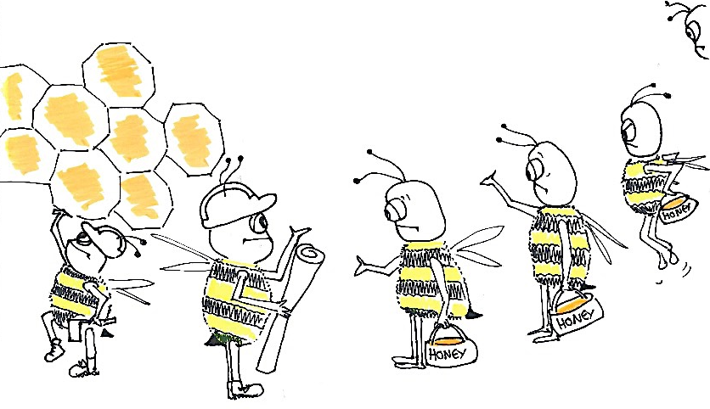
Back Pressure
@gracejansen27
Notes:
Form of feedback/flow control
Without feedback, a distributed system can easily become unstable and fail. Any component that cannot support the worst possible case of loading in the system can become a bottleneck. BLOCKING
Without Feedback, other components will continue to increase the load until they are in turn congested, resulting in the ultimate collapse!
When one component is struggling to keep-up, the system as a whole needs to respond in a sensible way.
It is unacceptable for the component under stress to fail catastrophically or to drop messages in an uncontrolled fashion.
Since it can’t cope and it can’t fail it should communicate the fact that it is under stress to upstream components and so get them to reduce the load.
This back-pressure is an important feedback mechanism that allows systems to gracefully respond to load rather than collapse under it.
this mechanism helps ensure that the system is resilient under load, and will provide information that may allow the system itself to apply other resources to help distribute the load, see Elasticity.
Backpressure = built wherever the publisher is faster than the subscriber
Honeycomb vs nectar ratio
Resiliency / responsiveness

Slide 17
Bulkheading
@gracejansen27
Notes:
Builhead use in industry to partition a ship into segments, so that sections can be sealed off if the hull is breeched.
--> concept can be applied in software development to segregate resources
Protect limited resources from being exhausted.
Dancer communicating how many bees should go to food source
Resiliency/responsiveness
Akka

Slide 18
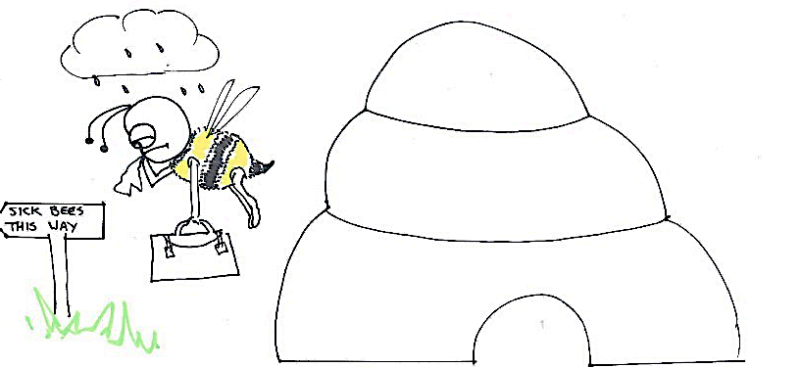
Circuit Breaking
@gracejansen27
Notes:
Bees are intelligent actors, software isn’t so we have to program to imitate it
Protect resources and help them recover
Circuit breaker opens when a particular type of error occurs multiple times in a short period.
An open circuit breaker prevents further requests to be made.
They usually close after a certain amount of time, giving enough space for underlying services to recover.
Resiliency
Akka

Slide 19







Reactive Frameworks
Spring Reactor
@gracejansen27
Notes:
third party libraries
RxJava is a Java VM implementation of Reactive Extensions: a library for composing asynchronous and event-based programs by using observable sequences.
Microprofile Reactive Streams is an integration SPI - it allows two different libraries that provide asynchronous streaming to be able to stream data to and from each other.
Play Framework is a web development framework that empowers developers to build highly scalable, lightning-fast applications with an ease unparalleled on the JVM. Play is built on top of Akka and Akka HTTP
Lagom is an opinionated microservices framework that builds on top of Akka and Play

Slide 20
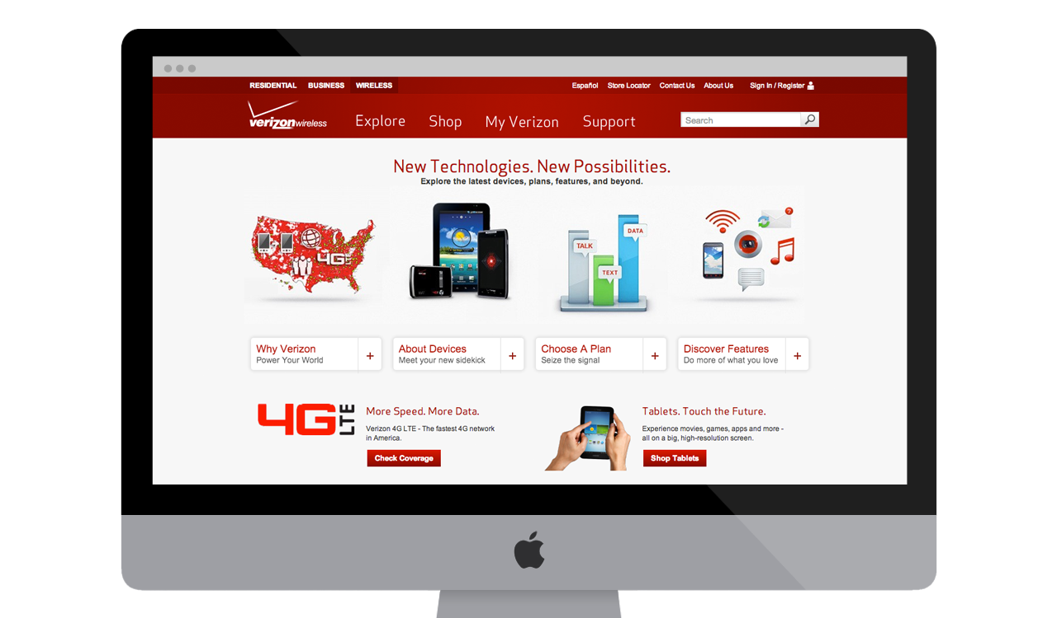
Real World Example -Verizon
175M Visits/Month
50M Unique Visitors/Month
2.5 Billion Interactions/Year
88% Interactions are Digital
48% Digital Sales on Mobile Devices
Always Up For Iconic Launch
@gracejansen27
Notes:
Switch off bits of system to deal with load of customers trying to buy new phones – reactive solved this
Google: “faster page loads, the more successful it will be”, people don’t want to wait
Performance plays a major role in the success of any online venture. Case studies that show how high-performing sites engage and retain users better than low-performing ones:
Pinterest increased search engine traffic and sign-ups by 15% when they reduced perceived wait times by 40%.
COOK increased conversions by 7%, decreased bounce rates by 7%, and increased pages per session by 10% when they reduced average page load time by 850 milliseconds (14.2 secs).
Here are a couple case studies where low performance had a negative impact on business goals:
The BBC found they lost an additional 10% of users for every additional second their site took to load.
DoubleClick by Google found 53% of mobile site visits were abandoned if a page took longer than 3 seconds to load.

Slide 21
Real World Example
Conversion rate UP by 1.6x (from 1.9% to 3.1%)
Page response time improved from 7-10 seconds to 2-3 seconds
Runs using 1/8th of Infrastructure
Deployment time improved from 4-8 hours to 30 minutes
Developers are 20-40% more productive
Order completion improved from 41 minutes to 27 minutes
@gracejansen27
Notes:
Lagom and Play

Slide 22
Why should you care?
Responsive
Elastic
Resilient
Message-Driven
@gracejansen27

Slide 23
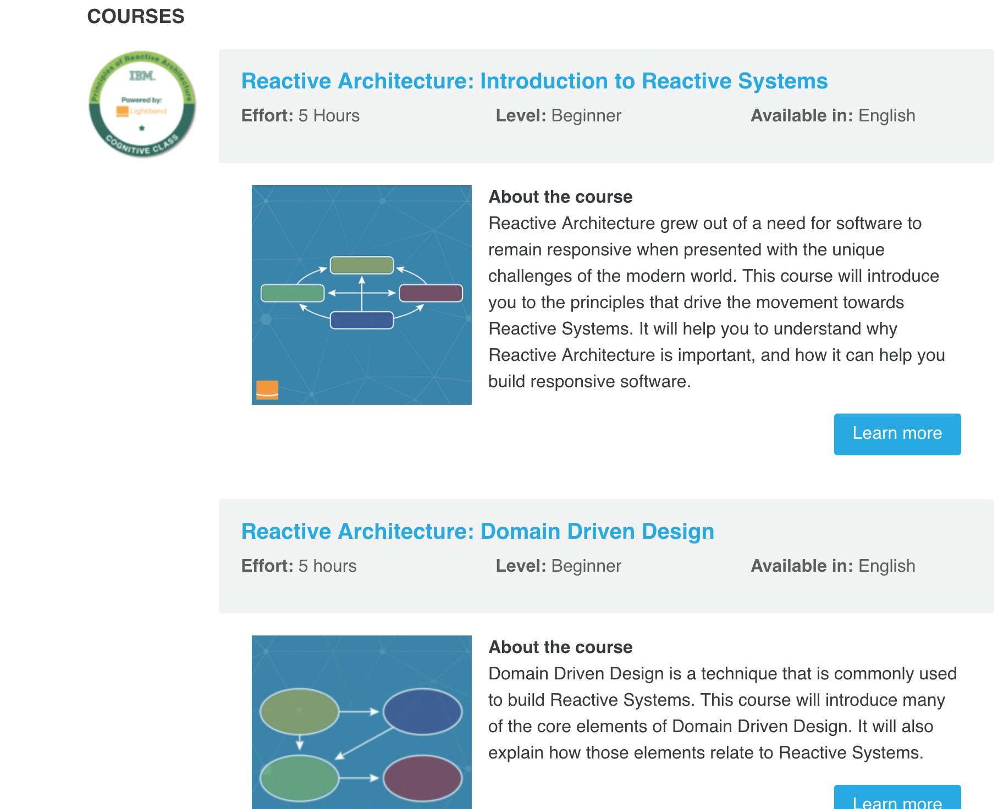
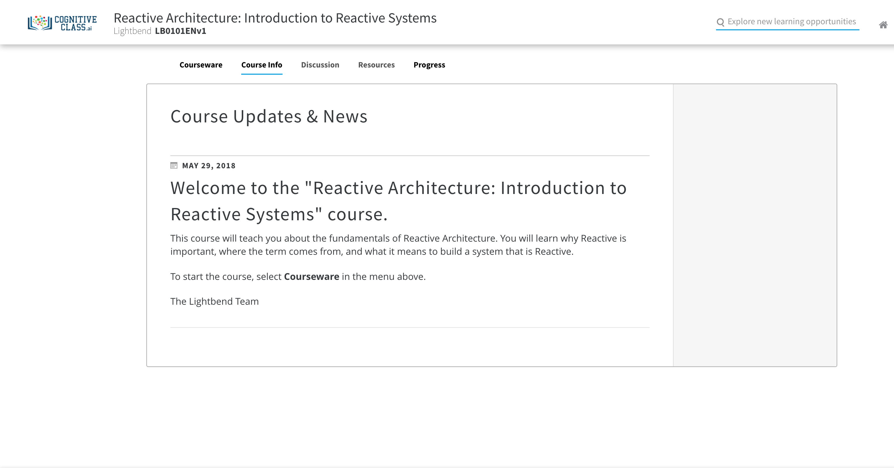
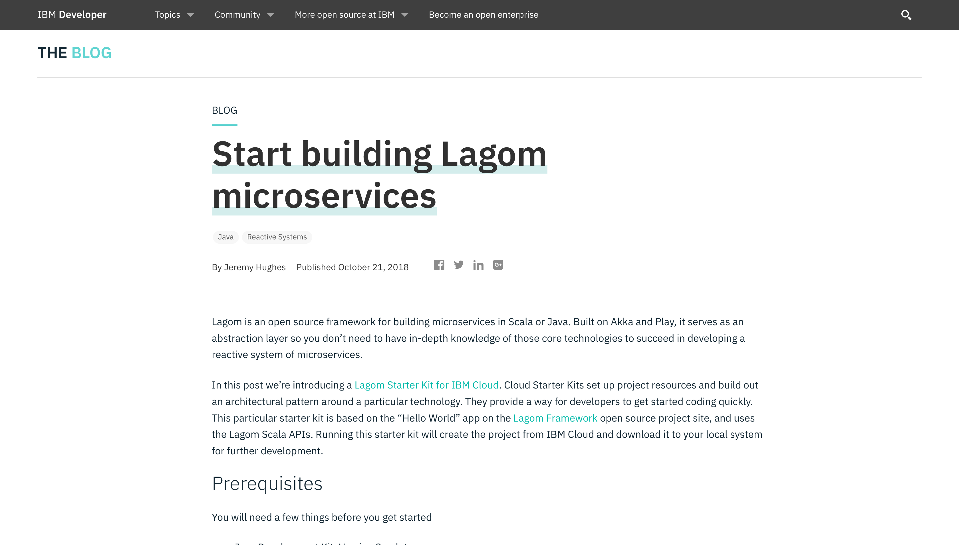
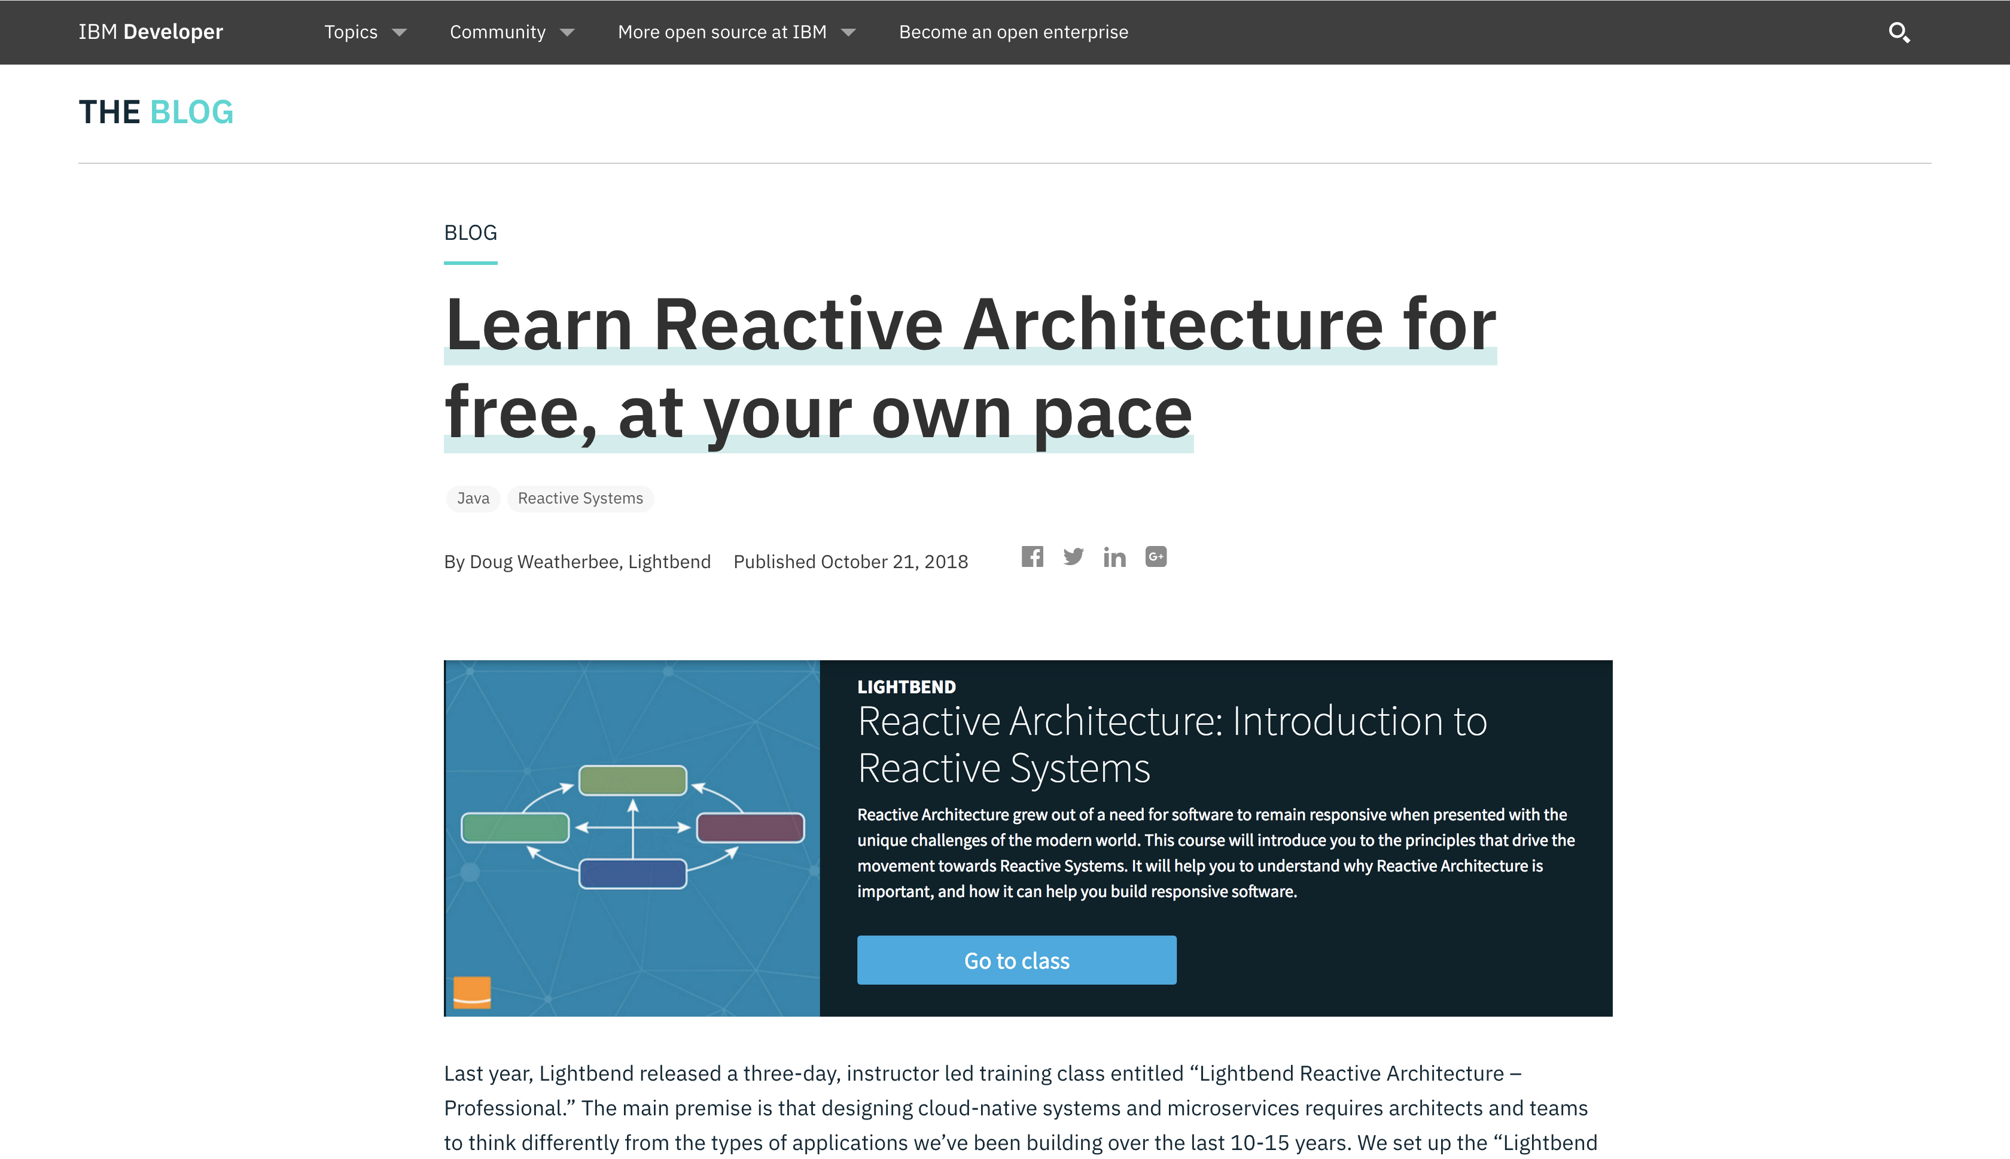
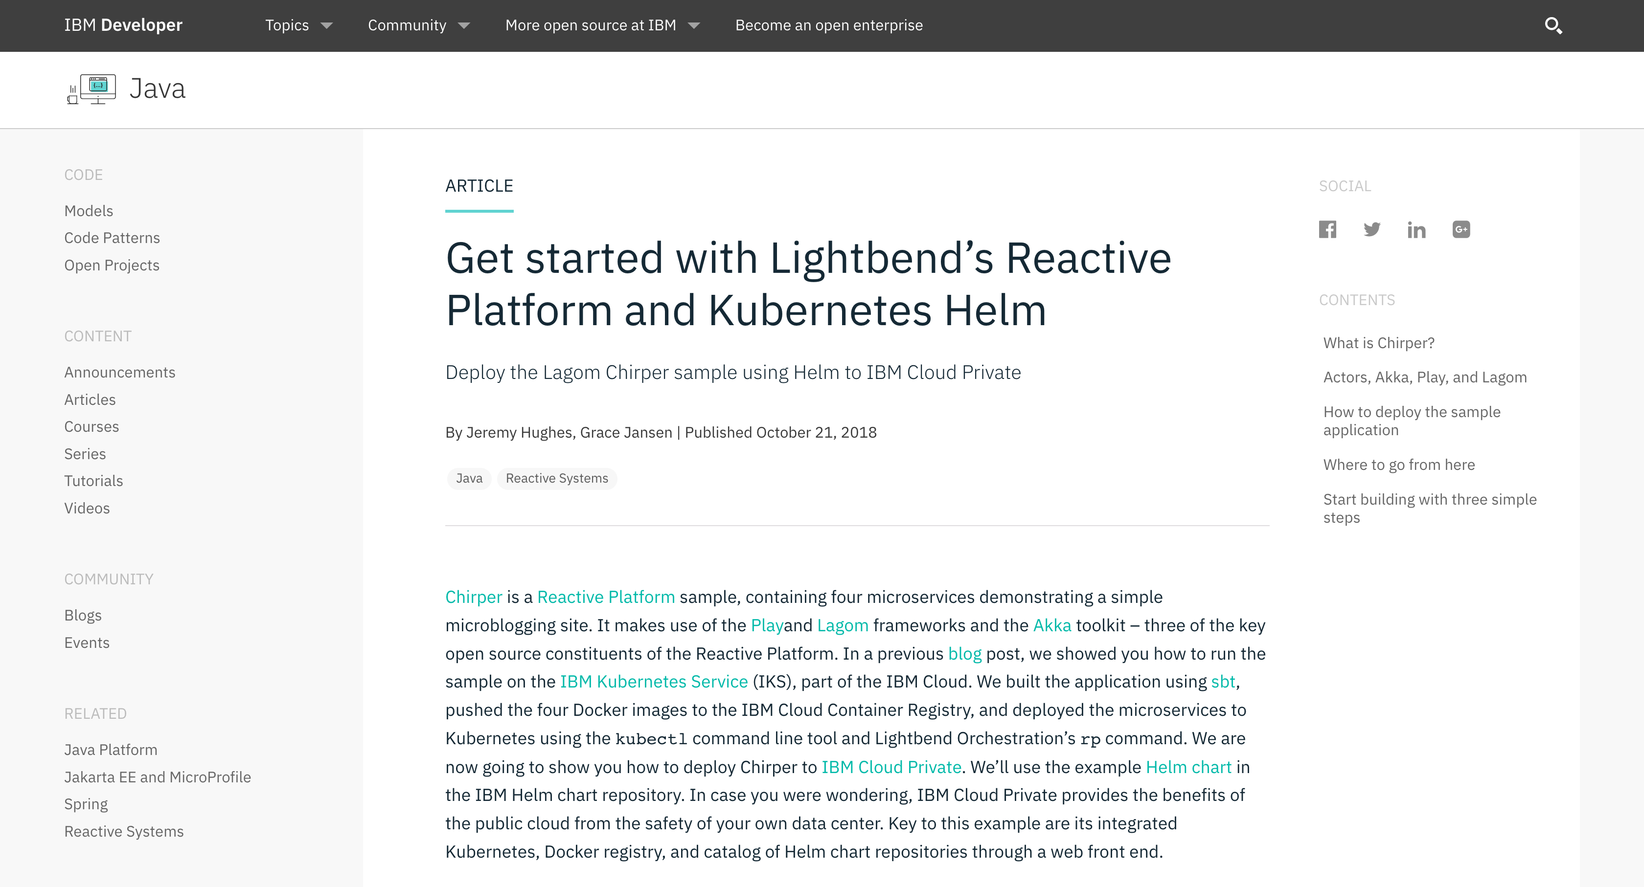
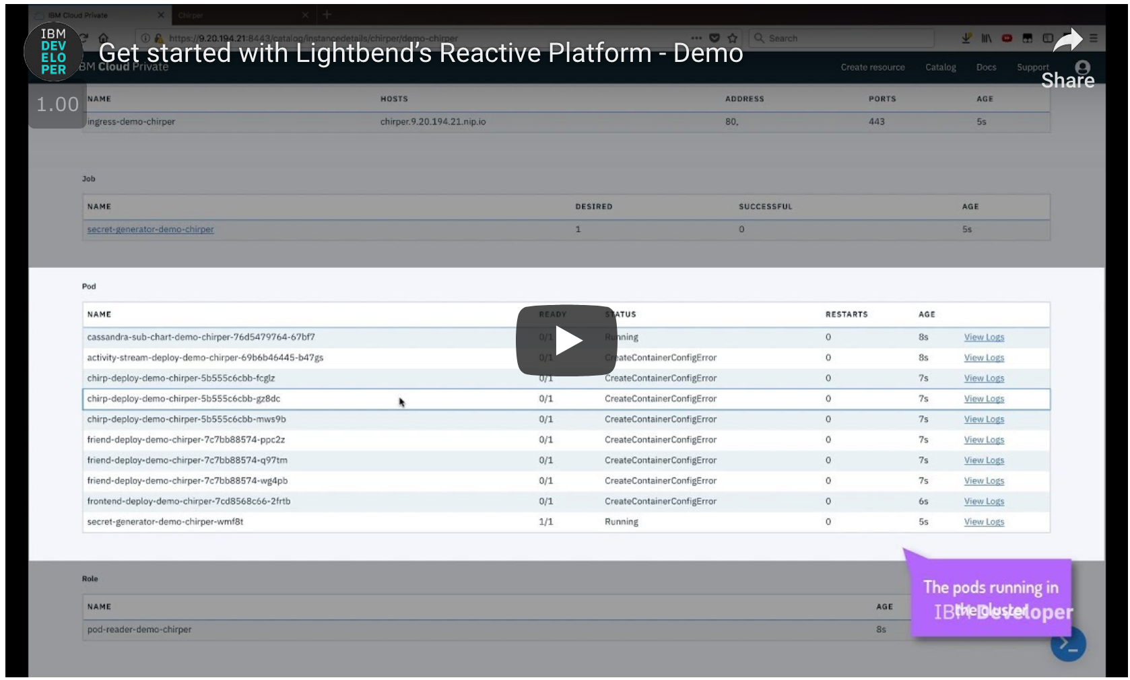
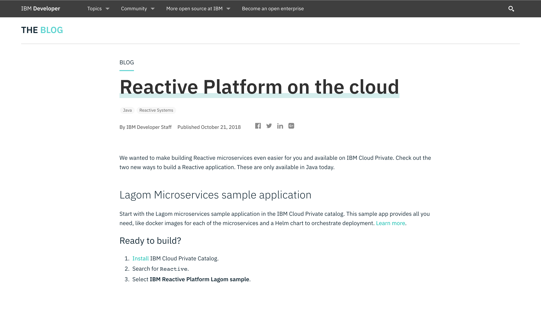
What Can You Do?

Slide 24
Links to Learn More
https://www.reactivemanifesto.org/
https://developer.ibm.com/series/reactive-in-practice/
https://www.oreilly.com/learning/why-reactive
https://www.lightbend.com/blog/understand-reactive-architecture-design-and-programming-in-less-than-12-minutes
https://akka.io/
https://www.lagomframework.com/
https://www.ibm.com/marketplace/reactive-platform
https://towardsdatascience.com/cap-theorem-and-distributed-database-management-systems-5c2be977950e
@gracejansen27

Slide 25



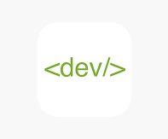
Thank You
@gracejansen27
https://www.linkedin.com/in/grace-jansen/

Slide 26
